Slide 1


Hybrid Cryptography for Automated Election System
Hipolito | Jovellano | Pachico

Slide 2
Abstract
The Philippines has been adopting the Automated Election System after years of adhering and relying on the Manual Voting System. It has been proven that the process became more efficient and generates results in a lesser time frame. However, complications are still evident in present time. For instance, the possibility of electoral fraud still continues to persist through the existence of secret servers in the last presidential election. This study aims to propose a technical solution that would eliminate the possibility of secret servers by implementing a public key infrastructure as security measures for the transmission of votes on the server-level.
Notes:
Joanna

Slide 3
Background of the Problem
Republic Act No. 9369 – “Amended Elections Automated Law”
The law states that Commission on Election (COMELEC) must use an Automated Election System (AES) that encourages “transparency, credibility, fairness, and accuracy.”
Implemented first in 2010 during the national presidential elections, and was again used in 2013 and 2016 elections.
Several issues regarding the security and reliability of the AES continue to arise for the past few years
Notes:
Joanna

Slide 4
Background of the Problem
For instance, during the 2016 elections, the camp of Senator Ferdinand Marcos Jr., who ran for the position of vice president, expressed his concerns with regard to the alleged “Secret Servers”.
Smartmatic’s Marlon Garcia, the head of the technical support team, admitted that aside from the three official servers that was authorized by the COMELEC (namely the Municipal Board of Canvassing Server, Central Server, and the Transparency server), there was also a “meet-me room” where several servers were housed.
The secret servers were intentionally not mentioned by the Comelec and Smartmatic to the public making it more suspicious.
Notes:
Joanna

Slide 5


Current System
Hash code serves as the file’s digital fingerprint and is “a security measure used to ensure that the integrity of an electronic document, data file, or a program has not been compromised.”
CNN Philippines, 2016
Transparency Server
Consolidation and Canvassing Server
Central Server
Handled by COMELEC
Handled by PPCRV
Votes are sent along with its hash code
Votes are sent along with its hash code
Votes are sent along with its hash code
VCM
Notes:
Joanna

Slide 6
Current System with Secret Server
Transparency Server
Consolidation and Canvassing Server
Central Server
Handled by COMELEC
Handled by PPCRV
Secret Server
Votes are sent along with its hash code
VCM
Notes:
Mikha

Slide 7
Background of the Problem
The purpose of the said “secret server” or the “queue server” is to first receive all the transmitted votes before distributing it to the three official servers declared by the COMELEC.
However, the normal process that should be done for the ER transmission as mandated by the law is to simply transmit the votes directly to the servers.
These “secret servers” never undergone the initial source code review which is essential in every machine that would be used during the elections.
There were no watchers assigned in the said server putting the integrity of the May 2016 election under a cloud of doubt
Notes:
Mikha

Slide 8
Background of the Problem
Furthermore, the ñ controversy showed that the entire automated election system uses a hash function called MD5.
Comelec-Smartmatic still used it even if many developers have suggested to avoid the usage of the technology.
Carnegie Mellon University – Software Engineering Institute stated that: “Software developers, Certification Authorities, website owners, and users should avoid using the MD5 algorithm in any capacity. As previous research has demonstrated, it should be considered cryptographically broken and unsuitable for further use.”
Recently, Microsoft announced Security Advisory 2862973 that will block the MD5 has algorithm. This hashing algorithm is quite long in the tooth and has not been a recommended hash for many years.
Notes:
Mikha

Slide 9
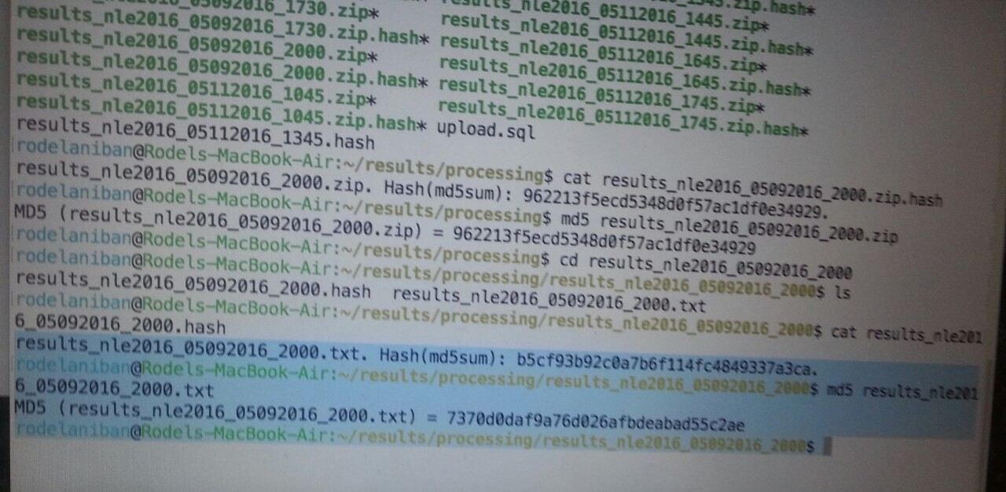
Background of the Problem
MD5 is just a hash function – not encryption at all.
Notes:
Mikha

Slide 10
Statement of the Problem
How can the Philippine automated election system eliminate the possibility of secret servers to secure the transmission of election returns on the server-level?
Notes:
Maj

Slide 11
Objectives
General Objectives
To know the vital issues currently present in the transmission of the votes
To propose a system that would prevent electoral fraud in the transmission of votes in the automated election system
Specific Objectives
To provide a technical solution that allows the verification of the servers’ authenticity through the use of a public key infrastructure as a security mechanism
Notes:
Maj

Slide 12
Significance of the Study
To the Filipino Citizens
This study will benefit the Filipino citizens for ensuring the security of the casted votes. Also, it would prevent malicious individuals from manipulating the votes.
To the COMELEC
This research would significantly contribute to the goal of the COMELEC to conduct a fair and transparent election.
To the Future Researchers
The system that would be created will serve as a guide and inspiration for other developers who would also want to pursue the prospect of automated election system.
Notes:
Maj

Slide 13
Scope and Limitations
The scope of the study would only include the issues and possible solutions for the security of the transmission of election returns on the server-level of the automated election system in the Philippines. Further study on the other parts of the automated election system will no longer be covered.
Notes:
Maj

Slide 14
Points to Improve
Some of the issues were:
Would the speed performance be affected by having multiple layers of security features?
How would the proposed system reliable if conducted to several thousand VCMs?
Notes:
Joanna

Slide 15
Project Update
Current update:
There is no issue with the speed of having multiple layers of hashing algorithms.
It is suggested to have a single server per level that would serve as the key generator.
However, another server (key generator) could be added in order to be the backup server in case the currently used server crashes.
Notes:
Joanna

Slide 16
Project Update
What’s next?
The prototype of the software would be developed and presented at the end of the term.
Objective:
To prevent devices from sending data to unauthorized servers
To authenticate all participating devices in data exchange
Notes:
Joanna

Slide 17






Prototype Design
Prototype design:
Not authenticated server
Authenticated server
Notes:
Joanna

Slide 18
Prototype Design
Prototype design:
Not authenticated server
Authenticated server
Notes:
Joanna

Slide 19
Project Vision and Scope Document
Business Requirements
The main objectives of the project are to know the vital issues currently present in the transmission of the votes, to propose a system that would prevent electoral fraud in the transmission of votes in the automated election system and to provide a technical solution that allows the verification of the servers’ authenticity through the use of a public key infrastructure as a security mechanism.
Notes:
Joanna

Slide 20
Project Vision and Scope Document
Business Opportunity
Currently, there is only one AES provider in the country which is the Smartmatic. This leads to monopolization of the technology. There is no competition in the market that makes it expensive.
Notes:
Joanna

Slide 21
Statement of Work
Introduction/Background
The project developers had recently conducted a research regarding the effectivity of the current Automated Election System in securing the data it carries from the VCMs and servers. To provide a solution to the problem, they formulated a security architecture design that can be used to secure the election returns. The developers also realized the importance of working with clients to develop tailored consulting solutions which can address the problem. Moreover, they believe that there can be an improvement with the current security features of the Automated Election System.
Notes:
Joanna

Slide 22
Statement of Work
Scope of Work
The scope of the study would only include the issues and possible solutions for the security of the transmission of election returns on the server-level of the automated election system in the Philippines. Further study on the other parts of the automated election system will no longer be covered.
Notes:
Joanna

Slide 23
Statement of Work
Period of Performance
The period of performance for the Hybrid Cryptography designed for the Automated Election System is 3 months beginning on 19 March 2016 through 22 December 2016. All work must be scheduled to complete within this timeframe. Any modifications or extensions will be carried on through the next phase of the project.
Notes:
Joanna

Slide 24
Statement of Work
Place of Performance
The selected vendor for the Hybrid Cryptography designed for the Automated Election System will be the project developers themselves and will assist the customer in need of the security architecture at its own facility. The vendor is required to meet with the client at least once a week in order to plan the and lay out the details of the added security features and also to check if the developed system satisfies the requirements as mandated by the law for the Philippine Elections.
Notes:
Joanna

Slide 25
Statement of Work
Schedule/Milestones
The below list consists of the initial milestones identified for the Website Redesign Project:
Version | Date | Author | Change Description
1.0 | 06/23/16 | Mikhaela Pachico | Document created
1.1 | 06/28/16 | Mikhaela Pachico | Changed the Research Focus Changed the Research Paper
1.2 | 06/30/16 | Mikhaela Pachico | Create Diagrams
1.3 | 07/07/16 | Joanna Hipolito | Update Diagrams
1.4 | 07/14/16 | Monique Jovellano | Finalized Documents
1.5 | 08/02/16 | Joanna Hipolito | Updated status of deliverables
Notes:
Joanna

Slide 26
Statement of Work
Schedule/Milestones
The below list consists of the initial milestones identified for the Website Redesign Project:
Version | Date | Author | Change Description
1.0 | 06/23/16 | Mikhaela Pachico | Document created
1.1 | 06/28/16 | Mikhaela Pachico | Changed the Research Focus Changed the Research Paper
1.2 | 06/30/16 | Mikhaela Pachico | Create Diagrams
1.3 | 07/07/16 | Joanna Hipolito | Update Diagrams
1.4 | 07/14/16 | Monique Jovellano | Finalized Documents
1.5 | 08/02/16 | Joanna Hipolito | Updated status of deliverables
1.6 | 08/07/16 | Mikhaela Pachico | Changed the research paper Planned the database design
1.7 | 08/16/16 | Mikhaela Pachico | Finalized Documents
1.8 | 08/23/16 | Monique Jovellano | Research Paper
1.9 | 09/26/16 | Joanna Hipolito | Plan for project development
2.0 | 10/03/16 | Monique Jovellano | Project Adviser
2.1 | 10/09/16 | Mikhaela Pachico | Draft for the plans in developing the system
2.2 | 10/17/16 | Mikhaela Pachico | Draft for CSPROJ Documents
2.3 | 10/23/16 | Joanna Hipolito | Finalized Documents for Applied Projects
Notes:
Joanna

Slide 27
Statement of Work
Acceptance Criteria
For the Hybrid Cryptography for AES Project, the acceptance of all deliverables will reside with the client’s executive officers that were assigned to work with the project developers. The personnel will maintain a small team of three advisors to ensure the completeness of each stage of the project and that the scope of work has been met. Once a project phase is completed and the vendor provides their report/presentation for review and approval.
Notes:
Joanna

Slide 28
Related Literature
Automated Election System
On election day, as the polls close, the BEI immediately administers the transmission of the votes or election returns via the VCMs to the servers and canvassing centers.
The primary channel used is through the public telecommunications networks and if that fails transmission will then be run through the satellite.
During the 2016 elections, congress will have their own server wherein the members of the senate and house of representatives can monitor the canvassing of the votes and to officially proclaim the winner for the national level.
Notes:
Joanna

Slide 29
Related Literature
Vote Transmission
Officially, there are three servers namely, the transparency server, the central server, and the canvassing center servers.
These servers are independent to each other making it harder to hack.
In order to rigged the election results, all three servers would have to be breached to make those results valid.
Notes:
Mikha

Slide 30
Related Literature
Issues in the System
During the 2016 elections, Bong Bong Marcos’ camp believes that there exists a “Fourth Server” or also known as the “Queue Server”.
Instead of letting the ERs be directly transmitted to the three official servers, namely the CCS, Central Server, and the Transparency server, the results were first being processed and consolidated in the “Queue Server”.
Notes:
Mikha

Slide 31
Related Literature
Hash Code
The Source code is a sequence of programming code typed by a computer programmer and is readable to humans. It is then converted into a machine readable form known as a compiled or executable program and is dependent to the source code.
Each source code is handles by the MD5 command that generates hash codes which serves as the digital fingerprint. The generated hash code is the assurance that whatever was been tested would be the same for the machines used for the elections.
Notes:
Joanna

Slide 32
Related Literature
PKI
The PKI is known for its complexity in managing certificates and keys which needs to be taken into account.
Implementing and managing a PKI is consequently a task not to be taken lightly, and one which will require both commitment and an appropriate level of expertise.
Notes:
Maj

Slide 33
Related Study
Experimental Design of Worldwide Internet Voting System using PK
Voter’s privacy was guaranteed by using blind signature.
PKI allowed worldwide key distribution and “one certificate-one vote” policy.
Anyone can participate as long as certificate was given Certificate Authority (CA).
Notes:
Maj

Slide 34
Theoretical Background
A Public Key Infrastructure is a combination of software and procedures providing a means for managing keys and certificates and using them efficiently.
Key and certificate management is the set of operations requires to create and maintain keys and certificates.
One of the major points being addressed in a managed PKI is the creation of keys and certificates.
A PKI must offer software support for key pair generation as well as certificate requests.
Notes:
Joanna

Slide 35
Theoretical Background
In asymmetric algorithm, two keys are used which is known as the public and private keys.
One key is provided to cipher the data and the other key is provided to decipher the data.
The key that is used to cipher data is publicly known but the other key that is used to decipher is a secret which means that the receiver holds the secret key and using this secret key the receiver can crack the encrypted texts sent by the others.
So, a protected information cannot be accessed as long as there is no key.
To ensure the authentication, these keys must be verified and current.
Notes:
Maj

Slide 36
Theoretical Background
This algorithm uses hard math problems for the keys mainly by factoring two large numbers since computers are capable of multiplying large numbers but cannot easily factor the product therefore, it will take time to break the key.
Furthermore, its main concerns are the confidentiality, integrity, authentication and non-repudiation of information.
The advantage of using this algorithm is that if one of the keys has been compromised then the other one is not affected and the guessing of the key algorithm is monitored.
With this, it will be easier to distinguish an intruder.
Notes:
Maj

Slide 37
Theoretical Background
The commonly used protocol is the Diffie-Hellman that is under the asymmetric algorithm.
In this encryption protocol, two people who have not contacted each other before can communicate by sharing a secret key to use for encryption.
This protocol is a one-way function which means that it is easy to encrypt but difficult to decrypt because in order to match the same key there is a mathematical formula that must be followed.
Moreover, Diffie-Hellman is known to be used for avoiding attackers from interrupting the transportation of information between two persons.
Notes:
Maj

Slide 38
Theoretical Background
In implementing Diffie-Hellman, two end-users must mutually agree on positive whole numbers of two variables, such that one variable is a large prime number and the other variable is the generator of that prime number.
Both end-users must choose a secret number then the user will compute for the public number.
After computing for the public numbers, exchange of public numbers will take place.
To finish, the computation of traded public numbers will result to their shared key without worrying about the other users obtaining this information.
In conclusion, Diffie-Hellman is an effective protocol because of the way it protects a temporary key for communication session.
Notes:
Maj

Slide 39
Theoretical Background
What is a hash code?
A hash code is a value – a combination of letters and numbers – generated by a function for an electronic document, data file, or program.
It serves as a digital fingerprint, meaning it is unique for every file, and is “a security measure used to ensure that the integrity of an electronic document, data file, or a program has not been compromised,” the National Citizens' Movement for Free Elections (NAMFREL) explained in a news release on Thursday (May 12).
Notes:
Mikha

Slide 40
Current System
MD5 may have vulnerabilities but the purpose of the hash function in the data’s integrity should still be considered when designing a system.
With that, it can be enhanced by implementing a hybrid public key infrastructure that can not only authenticate the data but also verify where it came from.
Notes:
Mikha

Slide 41
Proposed Solution to the problem
A hybrid public key infrastructure has to be implemented to not only authenticate the data being transmitted but to also allow the verification of the server’s authenticity.
In the proposed system, the three said official servers will have to send an encrypted data to the VCM first with the use of the public key of the said VCM.
The VCM then will have to decrypt the data using its own private key to verify that the data was indeed from an authentic server in the system.
Once the identification of the servers is verified, the VCM and the server can now create key exchange using the Diffie-Hellman algorithm that will yield its own generated key.
Once a key is generated, this will be used to encrypt the election returns and send to the servers.
The servers will have to verify the hash value of the election returns to check the integrity of the data as well as its origin.
Notes:
Joanna

Slide 42
Proposed System
Transparency Server
Consolidation and Canvassing Server
Central Server
Handled by COMELEC
Handled by PPCRV
Encrypted data using VCM’s public key
Decrypted data using VCM’s private key
Key exchange using the Diffie-Hellman algorithm
Encrypted election returns using the generated key
VCM
Notes:
Joanna

Slide 43
Proposed System
1
Transparency Server
Consolidation and Canvassing Server
Central Server
Handled by COMELEC
Handled by PPCRV
Encrypted data using VCM’s public key
Encrypted data using VCM’s public key
Encrypted data using VCM’s public key
VCM
Notes:
Joanna

Slide 44
Proposed System
2
Transparency Server
Consolidation and Canvassing Server
Central Server
Handled by COMELEC
Handled by PPCRV
Decrypted data using VCM’s private key
Decrypted data using VCM’s private key
Decrypted data using VCM’s private key
VCM
Notes:
Mikha

Slide 45
Proposed System
3
Transparency Server
Consolidation and Canvassing Server
Central Server
Handled by COMELEC
Handled by PPCRV
Key exchange using Diffie-Hellman algorithm
Key exchange using Diffie-Hellman algorithm
Key exchange using Diffie-Hellman algorithm
VCM
Notes:
Maj

Slide 46
Proposed System
4
Transparency Server
Consolidation and Canvassing Server
Central Server
Handled by COMELEC
Handled by PPCRV
Encrypted election returns using the generated key
Encrypted election returns using the generated key
Encrypted election returns using the generated key
VCM
Notes:
Joanna

Slide 47
Proposed System
5
Transparency Server
Consolidation and Canvassing Server
Central Server
Handled by COMELEC
Handled by PPCRV
Hash value verification
Hash value verification
Hash value verification
VCM
Notes:
Mikha

Slide 48
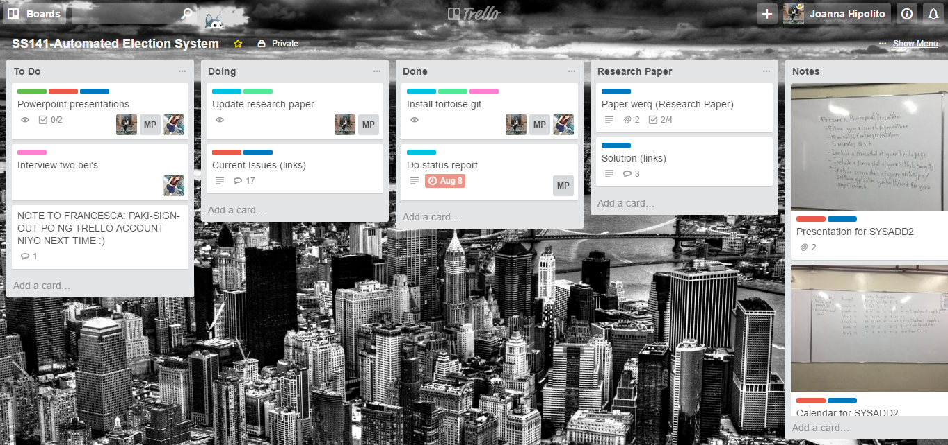
Trello Screenshot

Slide 49
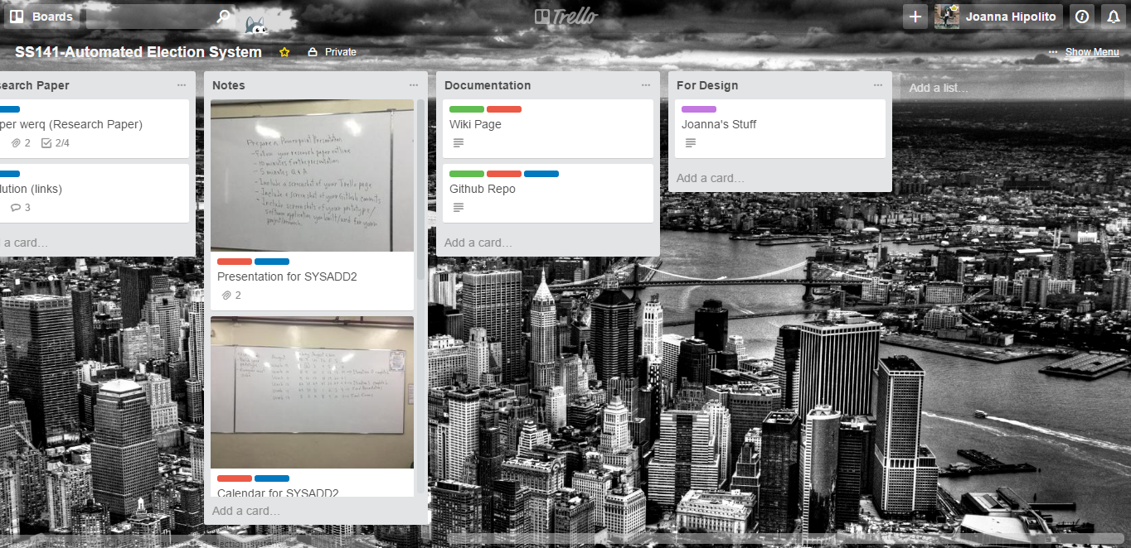
Trello Screenshot cont.

Slide 50
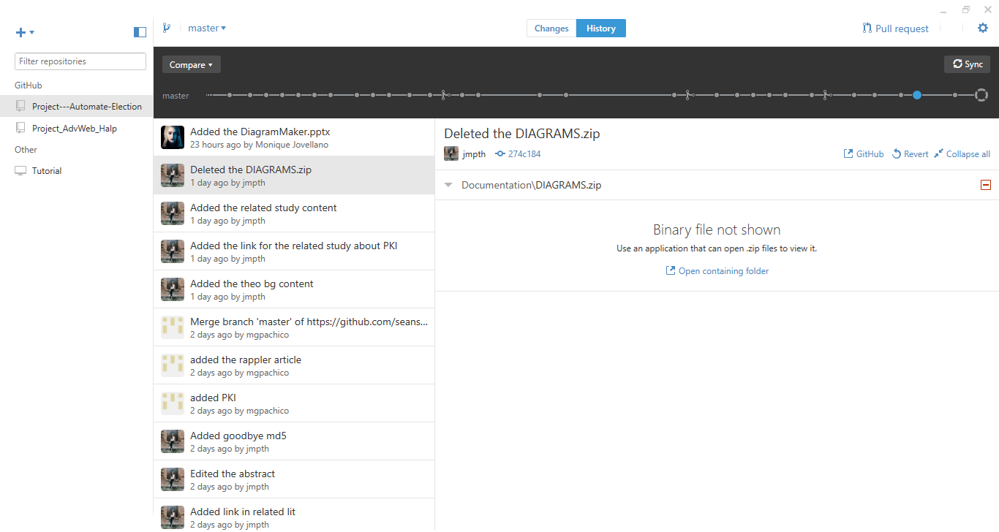
Github Screenshot

